Slide 1

Dream Team
Chasing the End

Slide 2
Team Members
Tyler
Jorge
Edgar
Luke
Brad

Slide 3

Advertising poster

Slide 4
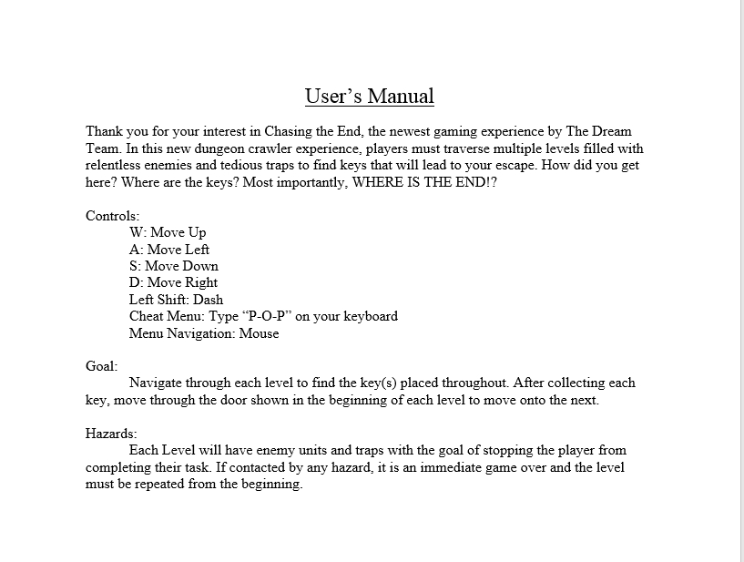
Users manual

Slide 5
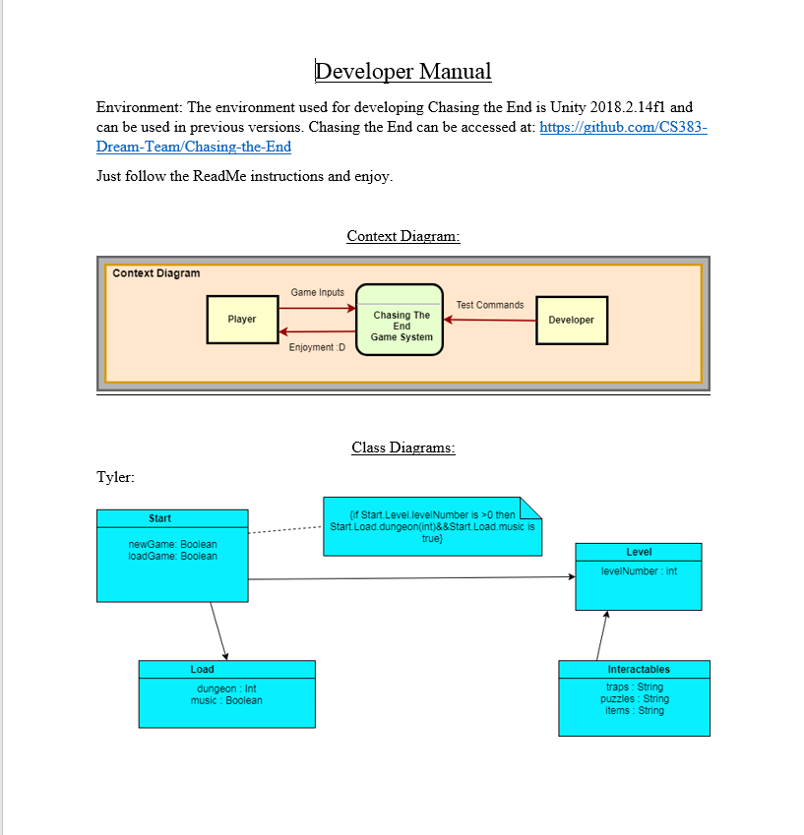
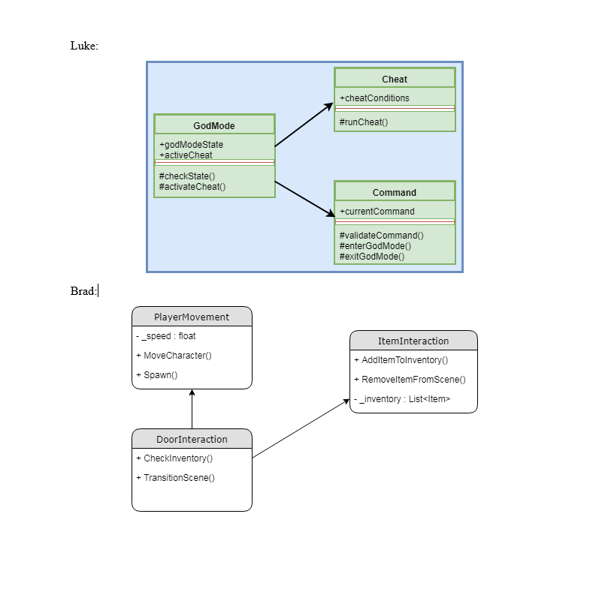
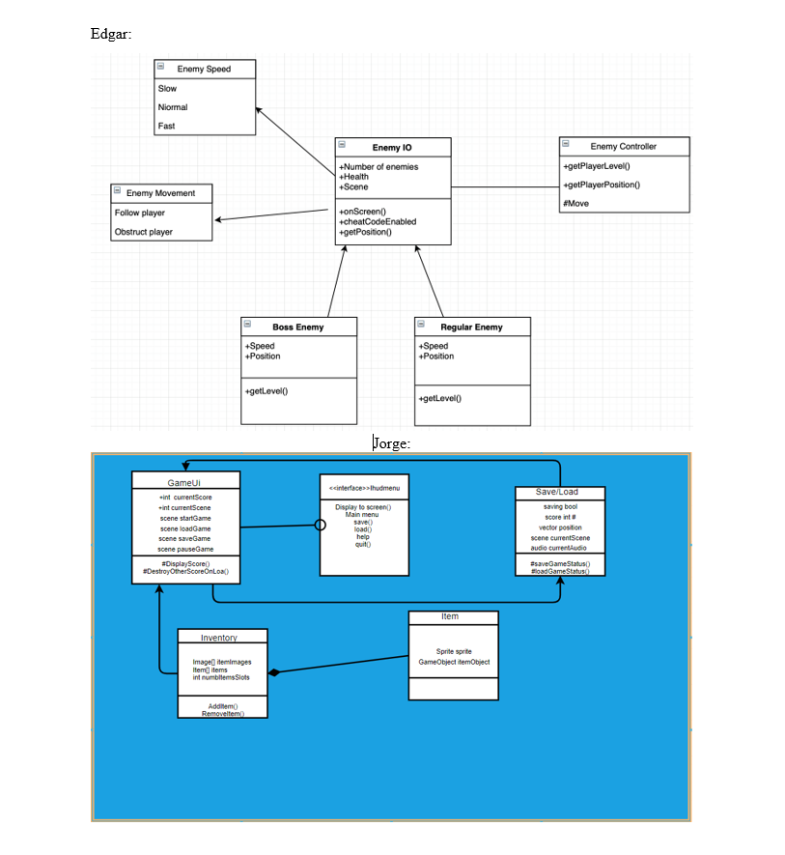
Developer’s manual

Slide 6
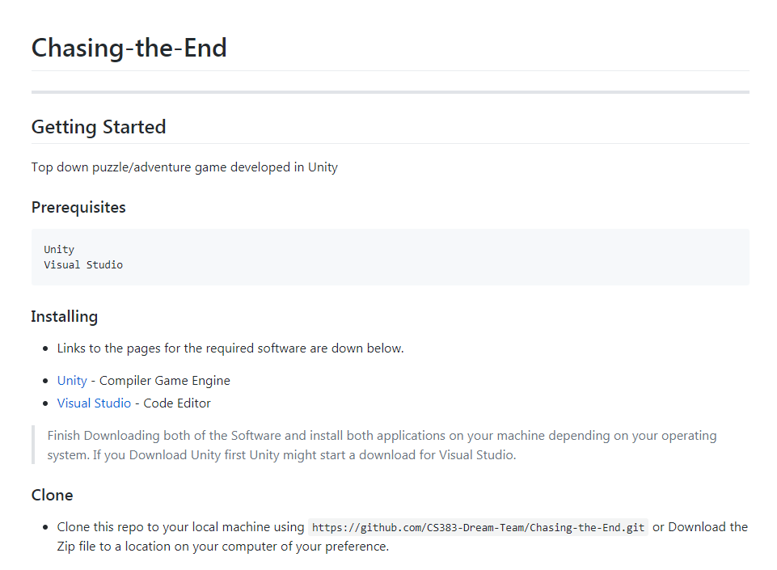
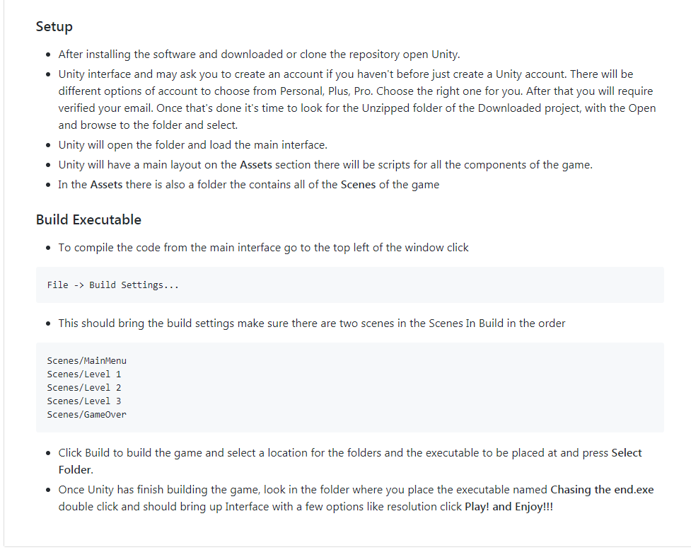
Readme

Slide 7
Gantt chart
https://docs.google.com/spreadsheets/d/1rT5_MF77FC6IMUi1A8PVjOCZcaJrHald6VAqmhyzRZA/edit#gid=0

Slide 8
Recent updates & uncommitted changes
https://docs.google.com/document/d/1Xesq1sseLGqrvhPyOTnQ-tmGKeiHLuIPztv2nM-wmFQ/edit

Slide 9
Any Questions?

